Slide 1



B.E. Major Project House Price Prediction Using Machine Learning
Aldel Education Trust’s
St. John College of Engineering and Management, Palghar
NAAC Accredited with Grade A (2017-2022)
DEPARTMENT OF COMPUTER ENGINEERING
Devyani Mandwade [EU1172015]
Ankita Mishra [EU1172053]
Saloni Raorane [ EU2152005]
Project Guide : Dr. Rahul Khokale
Co- Guide: Ms. Shraddha Dabhade
May 1,2021

Slide 2
Contents
Introduction
Motivation
Problem Statement
Objectives
Scope
Review of Existing Literature
Proposed System
Block diagram of Proposed System
Implementation
Algorithm/Flowchart
Dataset
Pseudo code
Screenshots of the output with description
Technologies Used
Results and Discussion
Conclusion and Future Work
References

Slide 3
Introduction
Data is the heart of machine learning. Predictive models use data for training which gives somewhat accurate results. Without data we can't train the model. Machine learning involves building these models from data and uses them to predict new data. Machine Learning is a subset of Artificial Intelligence.
Machine learning algorithms are purely based on data. Machine Learning algorithms are an advanced version of the regular algorithm. It makes programs “smarter” by allowing them to automatically learn from the data provided by us. The algorithm is mainly divided into two phases and that is the training phase and the testing phase.

Slide 4
Introduction
Motivation
The family purchase the house in city. They invest whole profit into house they don't have idea about that price of house at the certain area. So, sometimes they give extra money to builder for same construction and some distance. But they don't know about the two different prices of the model.
Problem Statement
The world is shifting from manual to automated systems. The objective of our project is to reduce the problems faced by the customer. In the present situation, the customer visits a real estate agent so that he/she can suggest suitable showplaces for his investments.

Slide 5
Objectives
To predict the house price according to the area.
To provide comparison of house pricing to customers.
To calculate house price depending upon surrounding environment like railway station, hospital area, ATM, college, banks so customer can purchase flat with full facilities
Scope
Prediction house prices are expected to help people who plan to buy a house so they can know the price range in the future, then they can plan their finance well.

Slide 6
Review of Existing Literature
2.1 Parth Ambalkar et al.; International Journal of Advance Research, Ideas and Innovations in Technology,2019[1]: In this research paper, they aim to predict housing price rates using these models i.e. Logistic Regression, Decision Tree and Support vector regression with its analogous accuracy and evaluate those based on different types of the error metrics like Root Mean Squared Error (RMSE), R- Squared, Mean Squared Error (MSE) and Mean Absolute Error (MAE). Author scraped data set from duProprio.com and Centris.ca. It consists of 25000 rows and 130 columns.
2.2 Darshil Shah, Harshad Rajput, Jay Chheda, International Research Journal of Engineering and Technology (IRJET),2020[2]: In this paper they have used CatBoost algorithm along with Robotic Process Automation for real-time data extraction. Robotic Process Automation involves the use of software robots to automate the tasks of data extraction while machine learning algorithm is used to predict house prices with respect to the dataset. They had used predefined opensource Kaggle Dataset consisting of 80 parameters, from which 37 parameters were chosen which were affecting house prices.

Slide 7
Proposed System
Creating a Machine Learning model to predict the home prices in Mumbai, India. We are going to use the dataset from Kaggle.com.
Below data science concepts are used in this project
• Data loading and cleaning
• Outlier detection and removal
• Feature engineering
• Dimensionality reduction
• Gridsearchcv
• K fold cross validation
Technology and tools used in this project
• Python
• Numpy and Pandas for data cleaning
• Seaborn
• Matplotlib for data visualization
• Sklearn for model building

Slide 8
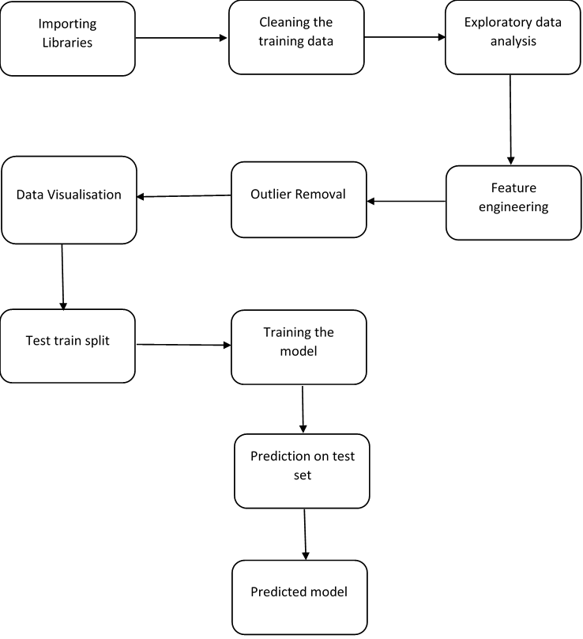
Proposed System
Fig. 1: Block diagram of the proposed system

Slide 9
Implementation
Dataset
Data Exploration
Data Cleaning
Data Selection
Data Transformation
Data Visualization

Slide 10
Output Table
Model | Best Score | Best Parametrs
Linear Regression | 0.911502 | {'normalize': True}
Lasso | 0.911442 | {'alpha': 1, 'selection': 'random'}
Decision Tree | 0.895215 | {'criterion': 'mse', 'splitter': 'best'}

Slide 11
Technologies Used
Python- Python is an interpreted, high-level and general-purpose programming language. Python's design philosophy emphasizes code readability with its notable use of significant whitespace. Its language constructs and object-oriented approach aim to help programmers write clear, logical code for small and large-scale projects. Python is dynamically typed and garbage-collected.
Spyder- Spyder is an open source cross-platform integrated development environment (IDE) for scientific programming in the Python language. Spyder integrates with a number of prominent packages in the scientific Python stack, including NumPy, SciPy, Matplotlib, pandas, Ipython as well as other open source software.
Numpy-NumPy is a Python library used for working with arrays. It also has functions for working in domain of linear algebra, fourier transform, and matrices.
Pandas-Pandas is an open-source, BSD-licensed Python library providing high-performance, easy-to-use data structures and data analysis tools for the Python programming language.

Slide 12
Technologies Used
Seaborn-Python Seaborn library is used to ease the challenging task of data visualization and it’s based on Matplotlib.
Sklearn-Scikit-learn (Sklearn) is the most useful and robust library for machine learning in Python. It provides a selection of efficient tools for machine learning and statistical modeling including classification, regression, clustering and dimensionality reduction via a consistence interface in Python.
Matplotlib-Matplotlib is an amazing visualization library in Python for 2D plots of arrays. Matplotlib is a multi-platform data visualization library built on NumPy arrays.
Gridsearchcv-GridSearchCV is a method to search the candidate best parameters exhaustively from the grid of given parameters. Target estimator (model) and parameters for search need to be provided for this cross-validation search method. GridSearchCV is useful when we are looking for the best parameter for the target model and dataset.

Slide 13
Results and Discussion
Till now we have implemented three techniques for house price prediction :
1.Linear Regression
2. Lasso Regression
3. Decision Tree
Linear Regression is a supervised machine learning algorithm where the predicted output is continuous and has a constant slope. It’s used to predict values within a continuous range, rather than trying to classify them into categories.
The “LASSO” stands for Least Absolute Shrinkage and Selection Operator. It is used over regression methods for a more accurate prediction.
Decision Tree is a Supervised learning technique. It is a tree-structured classifier , where internal nodes represent the features of a dataset, branches represent the decision rules and each leaf node represents the outcome.

Slide 14
Conclusion
From our implementation , we can conclude that among linear regression , decision tree and lasso regression , linear regression gives the more accurate output.

Slide 15
Further steps to implemented
To find the predicted price for a house with given area.
Estimate house price from number of bedrooms/bathrooms.
Evaluating Models
3 Best metrics to evaluate regression model
Mean Square Error(MSE)
Means Square Error is an absolute measure of the goodness for the fit. It gives you an absolute number on how much your predicted results deviate from the actual number.

Slide 16
2. Root Mean Square Error
RMSE is the standard deviation of the errors which occur when a prediction is made on a dataset. This is same as MSE but the root of the value is considered while determining the accuracy of the model.
3. Mean Absolute Error(MAE)
The MAE of a model with respect to a test set is the mean of the absolute values of the individual prediction errors on over all instances in the test set.
This measures the absolute average distance between the real data and the predicted data.

Slide 17
Paper Publication
Paper successfully published in GIS SCIENCE JOURNAL
ISSN NO:1869-9391
VOLUME 8,ISSUE 4,2021

Slide 18
References
[1] House Price Prediction Using Various Machine Learning Algorithms , Parth Ambalkar et al.; International Journal of Advance Research, Ideas and Innovations inTechnology,2019
[2] House Price Prediction Using Machine Learning And RPA, Darshil Shah, Harshad Rajput, Jay Chheda, International Research Journal of Engineering and Technology (IRJET),2020
[3] House Price Prediction via Improved Machine Learning Techniques , Quang Truong, Minh Nguyen, Hy Dang, Bo Mei , 2019 International Conference on Identification, Information and Knowledge in the Internet of Things (IIKI2019)
[4] A Hybrid Regression Technique for House Price Prediction, Sifei Lu, Zengxiang Li, Zheng Qin, Xulei Yang, Rick Siow Mong Goh, Institute of High Performance Computing (IHPC),2017
[5] Housing Prices Prediction with Deep Learning and Random Forest Esemble, Adyan Nur Alfiyatin, Hilman Taufiq, International Journal of Advanced Computer Science and Applications,(IJACSA)2017

Slide 19
References
[1] House Price Prediction Using Various Machine Learning Algorithms , Parth Ambalkar et al.; International Journal of Advance Research, Ideas and Innovations inTechnology,2019
[2] International Research Journal of Engineering and Technology (IRJET) Housing Price Prediction using Machine Learning Volume: 07 Issue: 05 | May 2020 www.irjet.net
[3] House Price Prediction via Improved Machine Learning Techniques , Quang Truong, Minh Nguyen, Hy Dang, Bo Mei , 2019 International Conference on Identification, Information and Knowledge in the Internet of Things (IIKI2019)
[4] A Hybrid Regression Technique for House Price Prediction, Sifei Lu, Zengxiang Li, Zheng Qin, Xulei Yang, Rick Siow Mong Goh, Institute of High Performance Computing (IHPC),2017
[5] Book Reference:
Hands-on Machine Learning with Scikit-Learn, keras & Tensorflow(2nd-edition)
Author: Aurelion Geron published by : O’Reilly Media

Slide 20
Thank You !!!

